Slide 1
Online student feedback system
Team Members
Name Enrollment no
1. Disha D. Chandgadkar 1809650291
2. Pooja S. Mangutakar 1709650090
3. Krutika K. Killedar 1709650078
4. Sandhya T. Patil 1809650290
Under the Guidance of:
Mr. V. S. Redekar
Notes:
We designed this template so that each member of the project team has a set of slides with its own theme where he/she can present their research. Members, here’s how you add a new slide to just your set:
Mark where you want to add the slide: Select an existing one in the Thumbnails pane, click the New Slide button, then choose a layout.
The new slide gets the same theme as the previous one you selected.
Careful! Don’t annoy your fellow presenters by accidentally changing their themes. That can happen if you choose a theme Variant from the Design tab, which changes all of the slides in your presentation to that look.

Slide 2
Introduction
We have developed Student Feedback System to provide feedback in an easy and quick manner to the college Principal as well as teaching staff.
So here in that Student Feedback System which delivers via the student staff interface as online system which acting as a Service Provider. By using this technology we can make fast feedback about the staff by student on time on head of all departments as they referred in online system.
This project has module Student login, HOD login and Principal login the registration form then they give feedback in system provided by college staff. This Feedback is checked by HOD.

Slide 3
Problem statement
The existing system carries more time to do a piece of work for this reason the online system feedback can be used.
The exiting system needs high manual efforts to manage the student feedback.
Loss of records.
High paper works.
Response is slow.

Slide 4
Objectives
In order to get a productive feedback, the collage has prepared a questionnaire to be filled by the students which covers the key points regarding a lecture.
Initially it was done manually but considering new trends, colleges started this system online which is cost effective and well as convenient for students.
This is a web application that saves paper cost and time of manual record maintenance.

Slide 5
Need of Feedback System
This type of Student Feedback system reduces, the strenuous work of physically examining the feedback pages of each and every student.
Student Feedback System for college students have been developed which aims to rate and analyses general college performance.

Slide 6
Proposed System
The ‘Feedback System’ Approaches all about institutional practices and processes that are taken into consideration, the student’s concerns of the level of the knowledge they receive. The College Feedback System is a management information system for education establishments to manage student data. An Online Student Feedback System is an automatic feedback generation system that provides the proper feedback to the teachers as per the categories like always, poor, usually, very often, sometimes

Slide 7
System Requirements:
Software Requirements
Hardware Requirements minimum
Software: Xampp Server, windows 7 and above
Hard Disk : 300
RAM : 2GB

Slide 8
Technology is used in designing
Front End- HTML, CSS, JavaScript, PHP
Back End – MySql

Slide 9
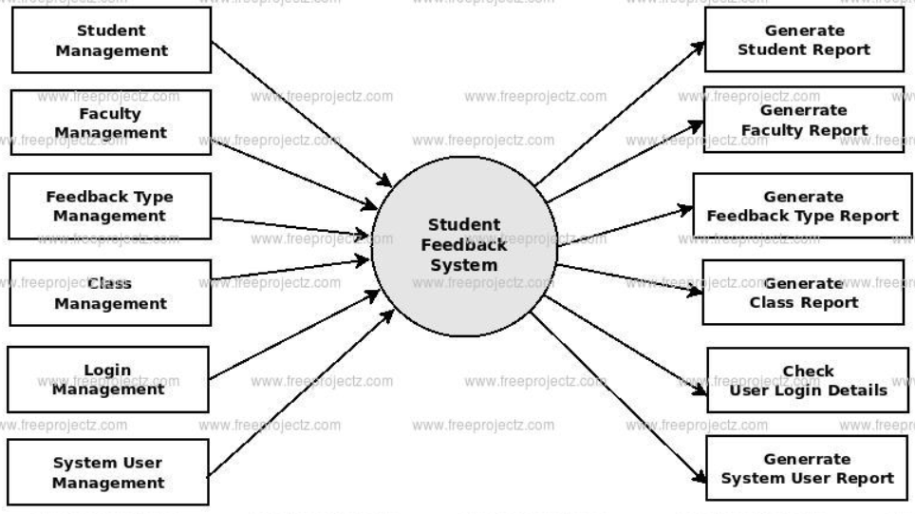
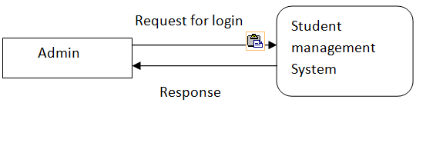
Data Flow Diagram
DFD 0-level
DFD 1-level

Slide 10
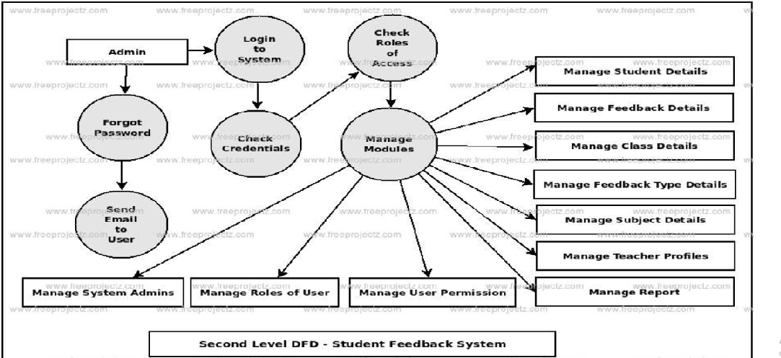

Slide 11
Module in Project
Home page
Registration form
Student Login
HOD Login
Principle Login

Slide 12
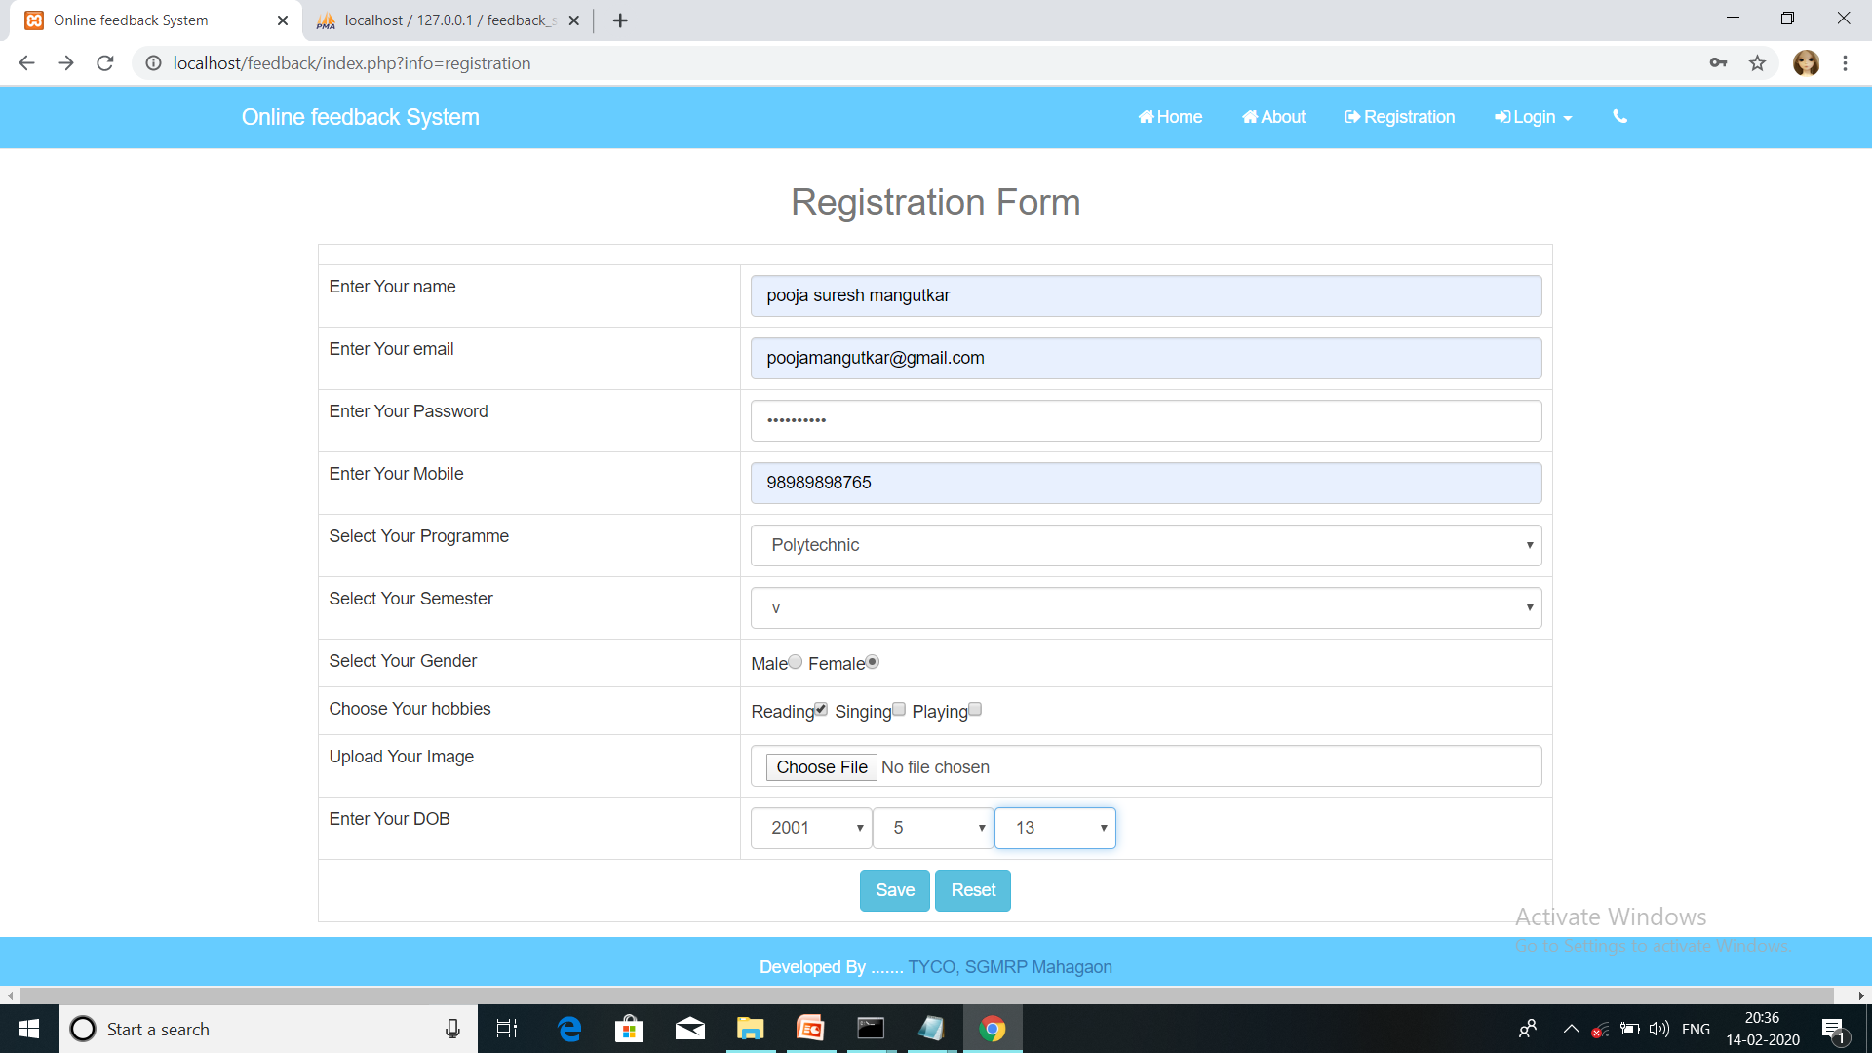

Slide 13
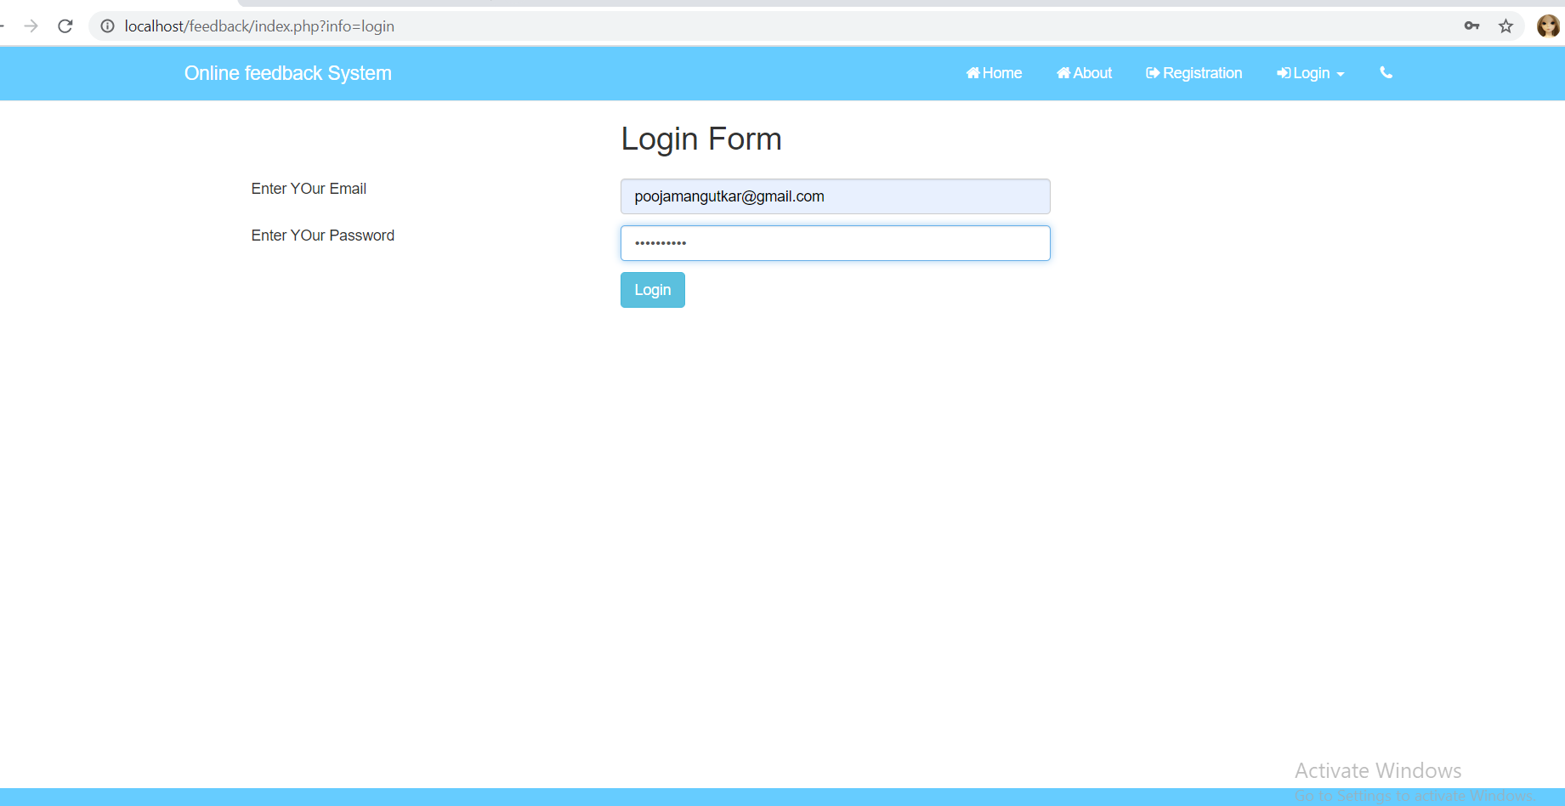

Slide 14
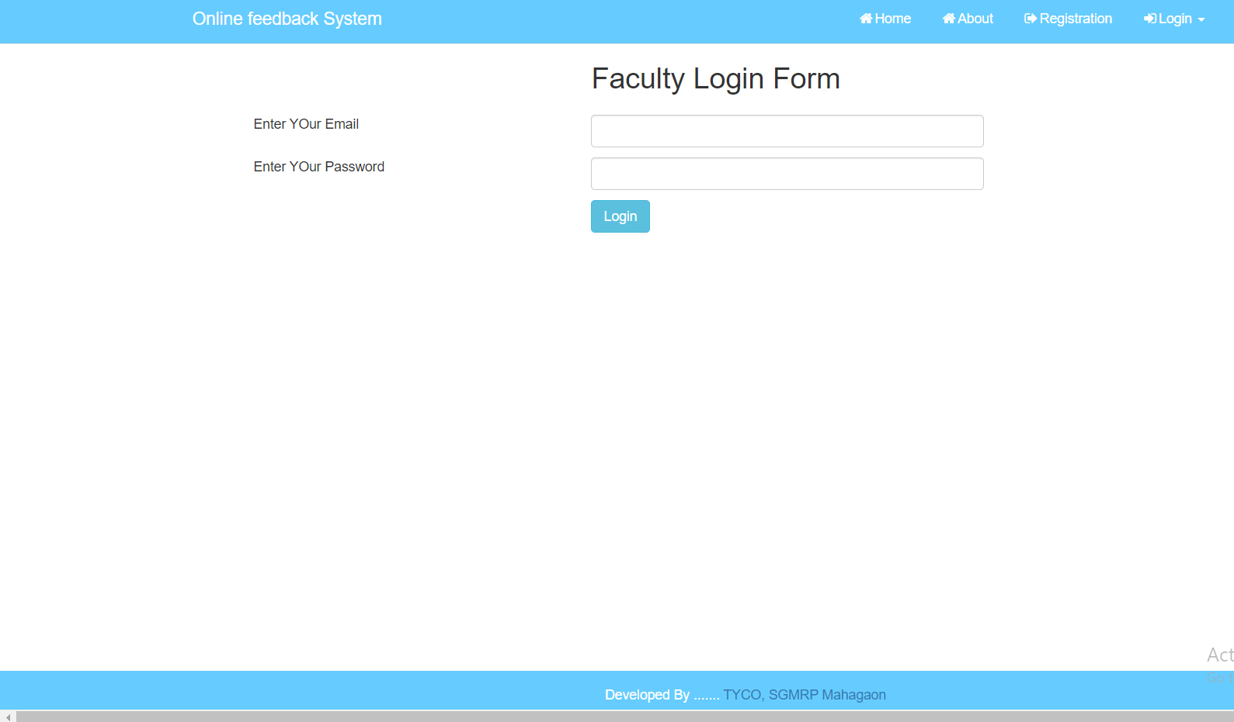

Slide 15
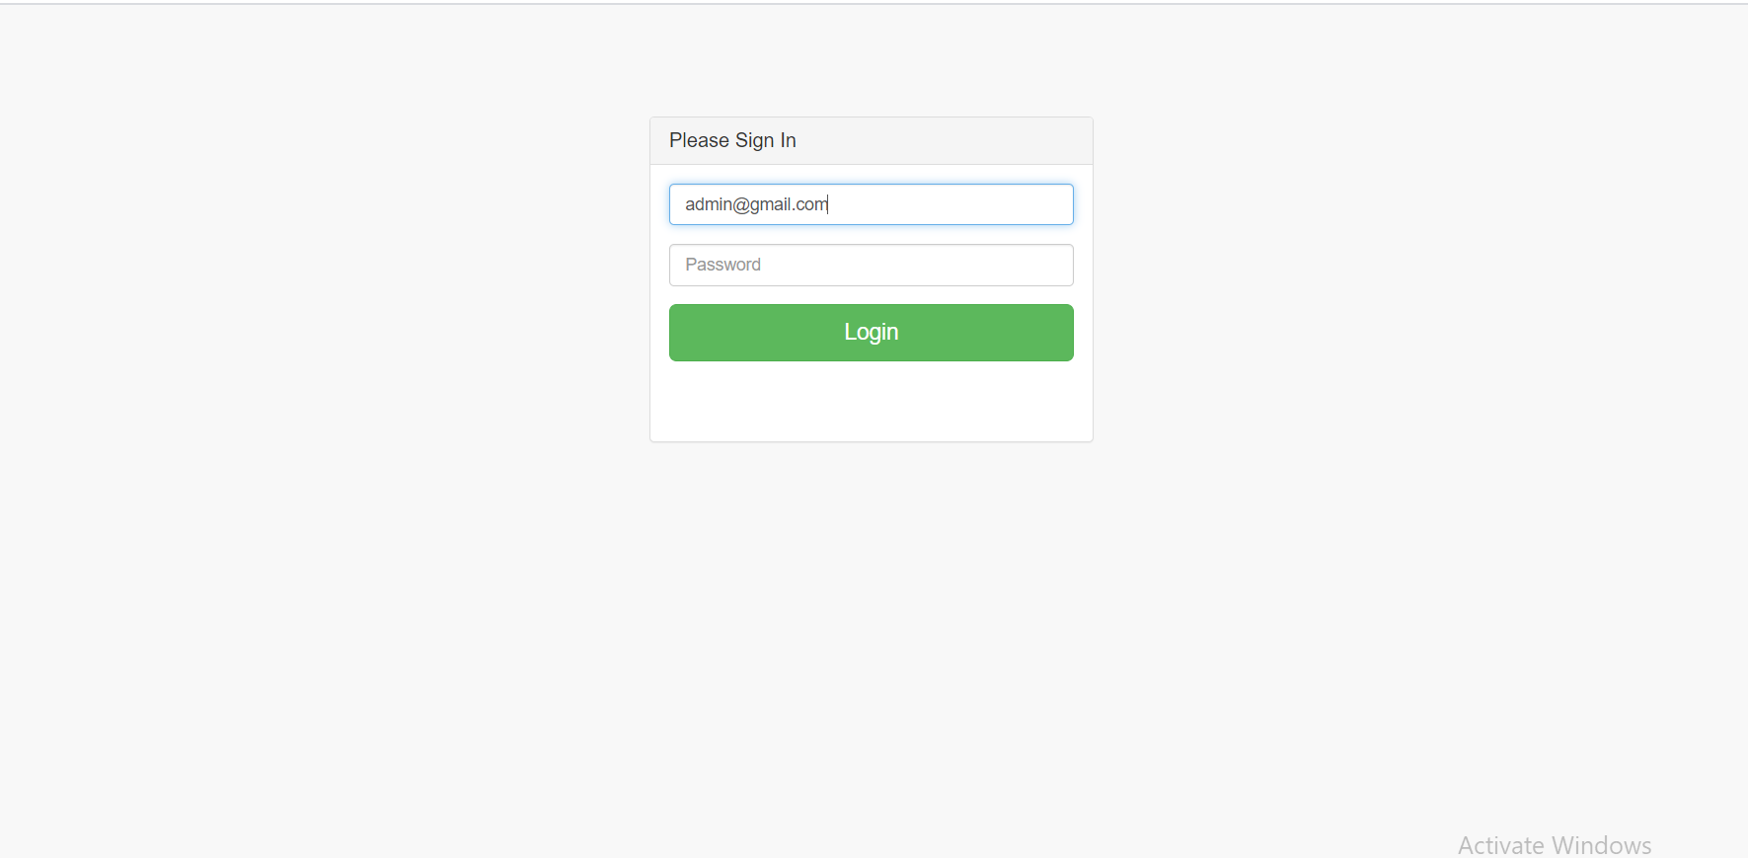

Slide 16
Pending Work
Admin other forms
Database Design

Slide 17
Advantages
True Feedback.
Secrecy maintained.
User friendly and cost effective.
That helps in increase efficiency of lectures

Slide 18
Web Reference
WWW.php.net
codecademy.com
http://udacity.com/

Slide 19
Thank You

